Slide 1



KONGU ENGINEERING COLLEGE
PERUNDURAI ERODE-638060
IOT & CLOUD MINI PROJECT
SMART ALARM SYSTEM AND MONITORING USING THINGSPEAK
TEAM MEMBERS:
RAMYA SHRI T (20CSR166)
RITHIKA B (20CSR170)
SANJAY B (20CSR183)
Date : 15/05/2023

Slide 2
OBJECTIVE:
Object detection plays a major role in security system.Now security systems are implemented in several places like office , hospitals, schools, colleges, parking lots, etc..In this project, we implemented an alarm system to detect objects by measuring distance using Ultrasonic sensor also we monitored distance and count data on the cloud using Thingspeak which acts as a cloud service provider.

Slide 3
REQUIREMENTS:
Raspberry Pi
Ultrasonic sensor
Jumper Wires
Buzzer
LED
Connecting Wires

Slide 4
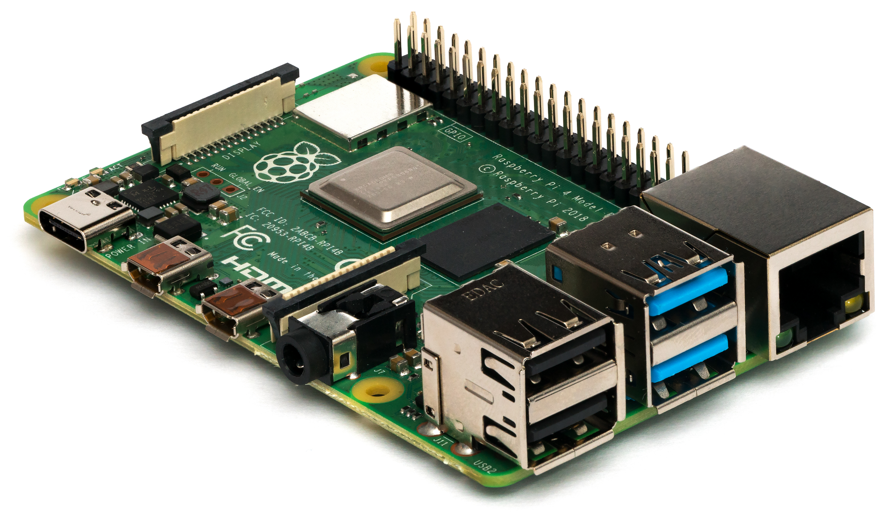
RASPBERRY PI:
The Raspberry Pi is a low cost, credit-card sized computer that plugs into a computer monitor or TV, and uses a standard keyboard and mouse.
It is a capable little device that enables people of all ages to explore computing, and to learn how to program in languages like Scratch and Python.
It is capable of doing everything you’d expect a desktop computer to do, from browsing the internet and playing high-definition video, to making spreadsheets, word-processing, and playing games.

Slide 5
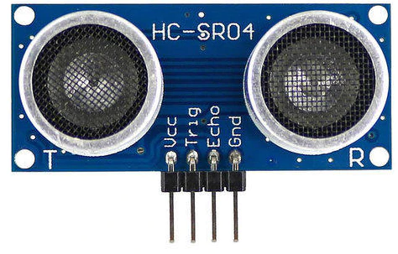
ULTRASONIC SENSOR:
An ultrasonic sensor is an electronic device that measures the distance of a target object by emitting ultrasonic sound waves, and converts the reflected sound into an electrical signal.
Ultrasonic waves travel faster than the speed of audible sound (i.e. the sound that humans can hear).
Ultrasonic sensors have two main components: the transmitter (which emits the sound using piezoelectric crystals) and the receiver (which encounters the sound after it has travelled to and from the target).

Slide 6
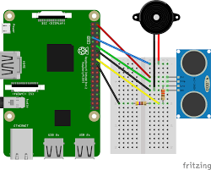
CIRCUIT DIAGRAM:

Slide 7
PROGRAM:
import time
import urllib2
import RPi.GPIO as GPIO
trig = 2
echo = 3
led1 = 17
led2 = 14
buzzer = 4
myapi="CNHNEA1BMIZA5O0W"
baseurl = "https://api.thingspeak.com/update?api_key=%s"%myapi
GPIO.setwarnings(False)
GPIO.setmode(GPIO.BCM)
GPIO.setup(trig,GPIO.OUT)
GPIO.setup(echo,GPIO.IN)
GPIO.setup(buzzer,GPIO.OUT)
GPIO.setup(led1,GPIO.OUT)
GPIO.setup(led2,GPIO.OUT)

Slide 8
def read_distance():
alert =0
GPIO.output(trig,True)
time.sleep(1)
GPIO.output(trig,False)
pulse_st=time.time()
while GPIO.input(echo)==0:
pulse_st= time.time()
pulse_end=time.time()
while GPIO.input(echo)==1:
pulse_end=time.time()
pulse_durat = pulse_end - pulse_st
distance = pulse_durat*17150
distance = round(distance,2)
if(distance <10):
alert=20
GPIO.output(buzzer,True)
GPIO.output(led2,False)
GPIO.output(led1,False)
print("Danger Alert")

Slide 9
elif(distance>10 and distance <100):
alert=10
GPIO.output(buzzer,False)
print("Red Alert")
GPIO.output(led1,True)
GPIO.output(led2,False)
else:
alert=5
GPIO.output(buzzer,False)
GPIO.output(led2,True)
GPIO.output(led1,False)
print("Normal")
return distance,alertwhile True:
distance,alert = read_distance()
print(distance)
print(alert)
conn = urllib2.urlopen(baseurl+'&field1=%f' %(distance)
+'&field2=%f' %(alert) )
conn.close()
time.sleep(0.5)

Slide 10
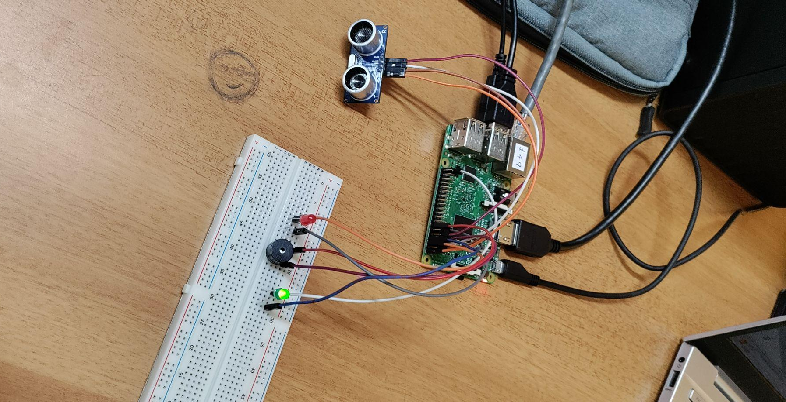
CIRCUIT CONNECTION :

Slide 11
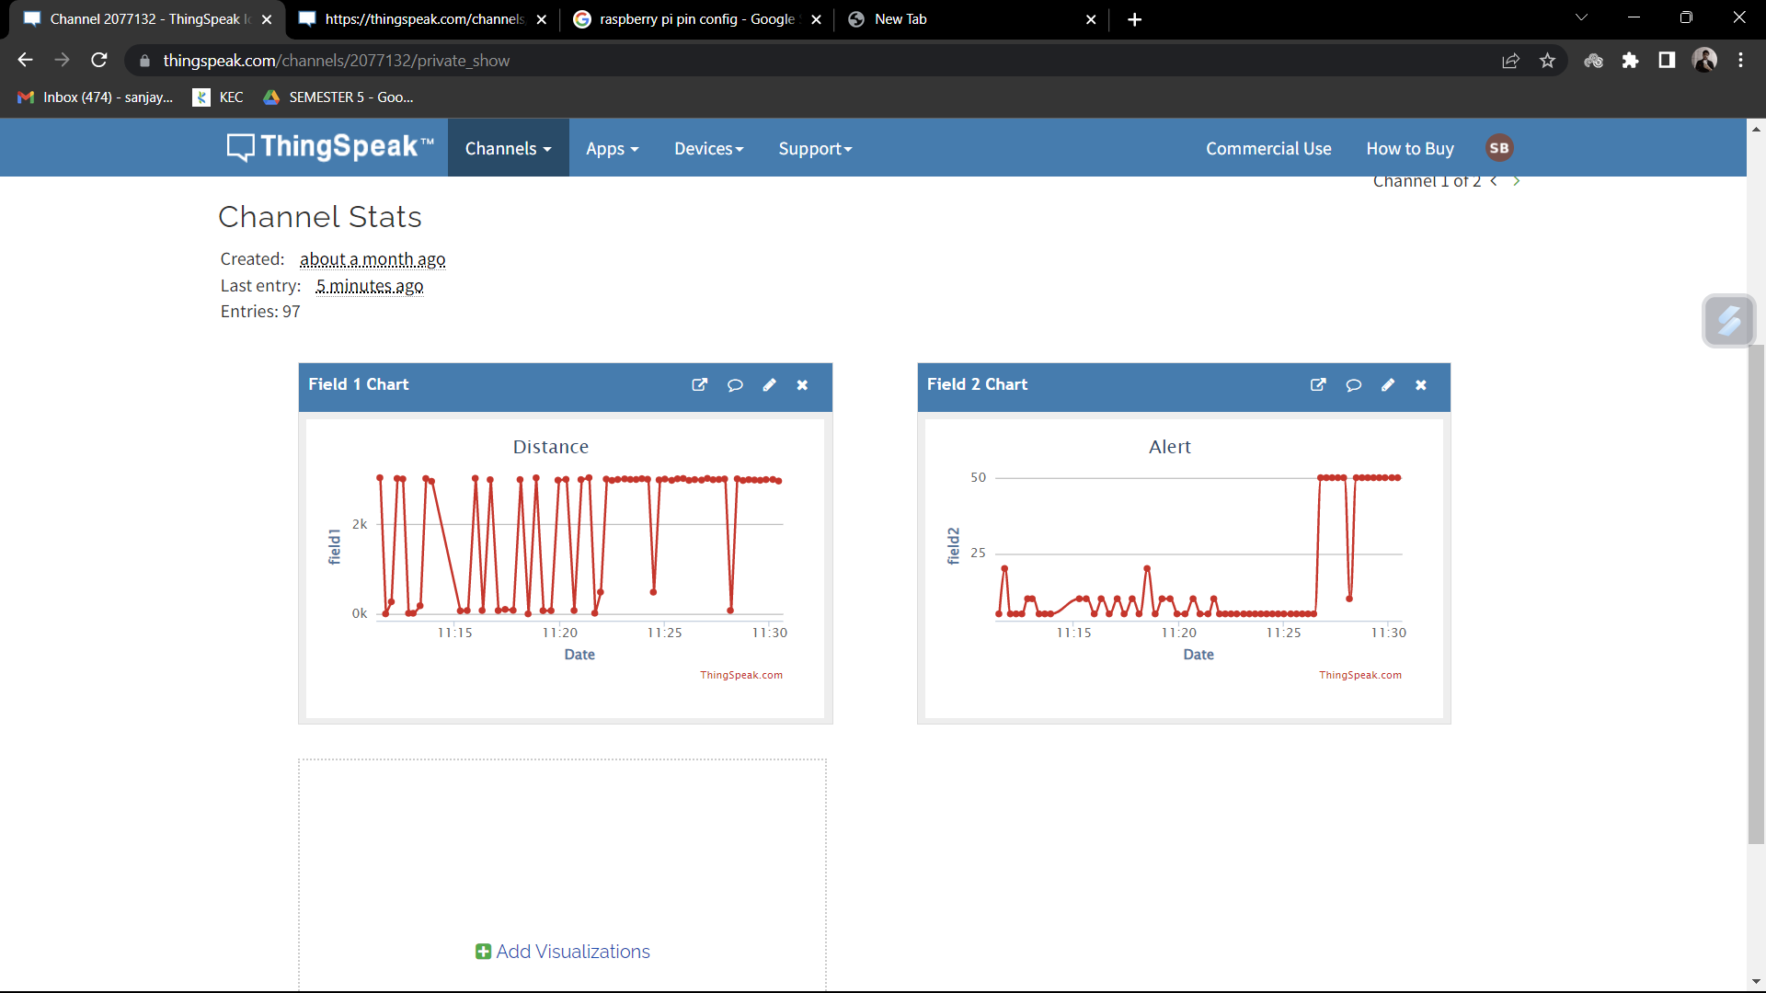
THINGSPEAK OUTPUT:

Slide 12
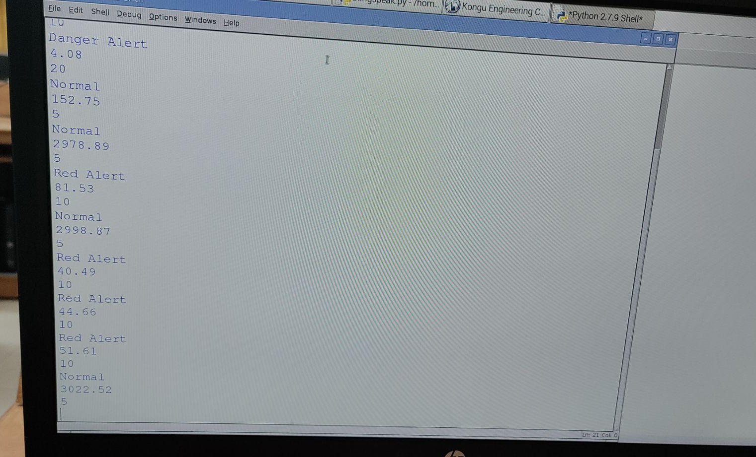
OUTPUT:

Slide 13
Thank You !!

